Slide 1
Delicious Goat Milk Project Status

Slide 2
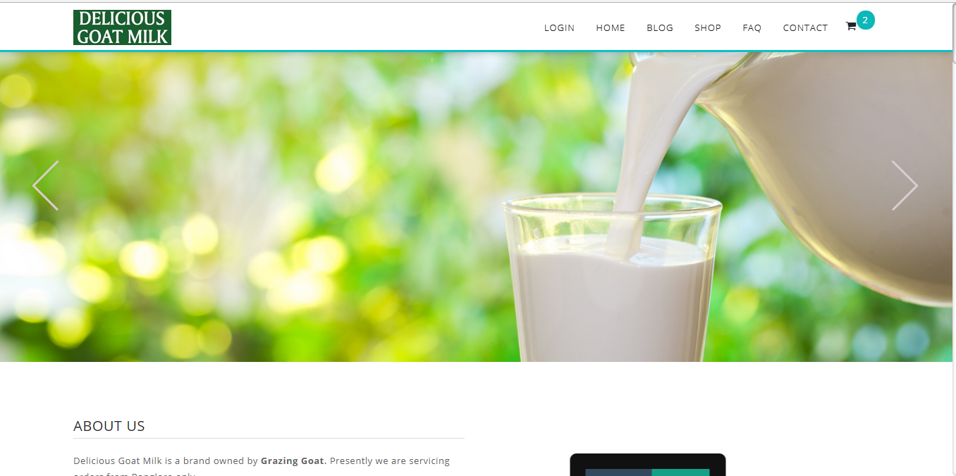
Home Page

Slide 3
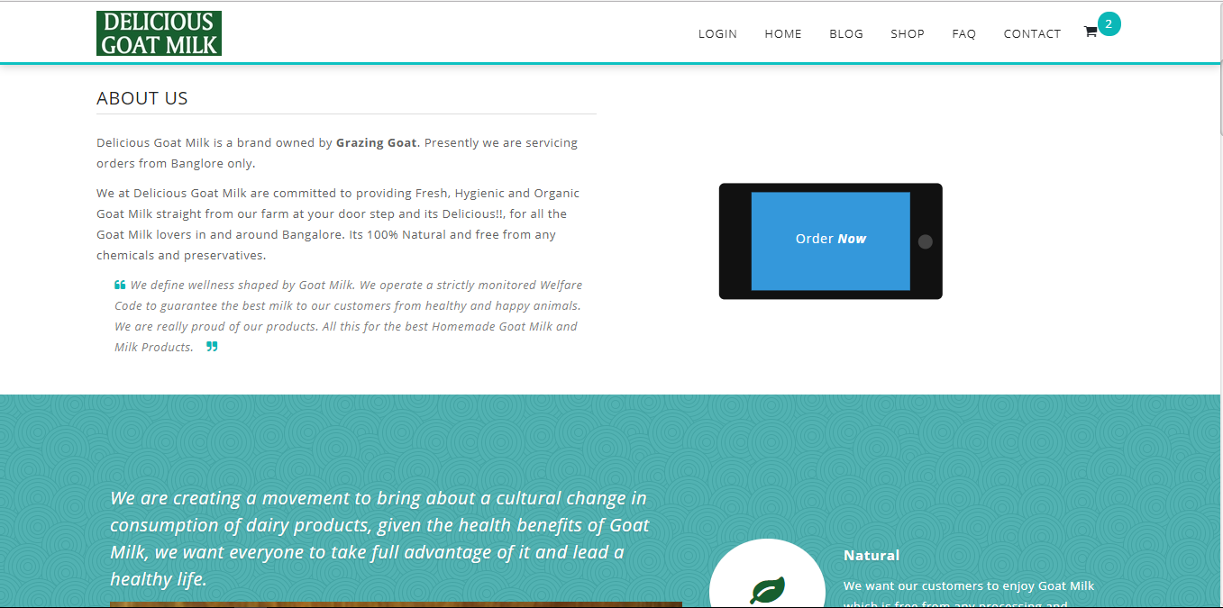
Home Page

Slide 4
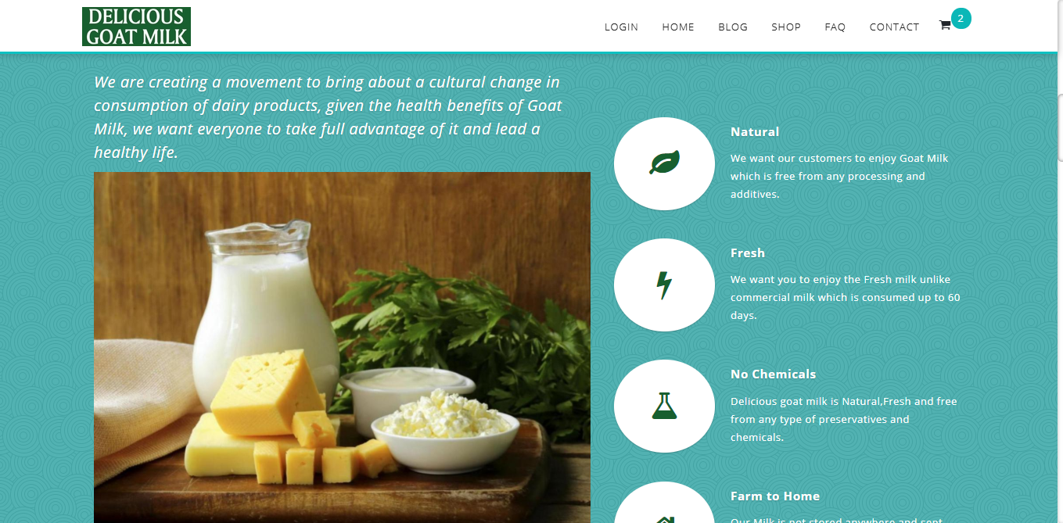
Home Page

Slide 5
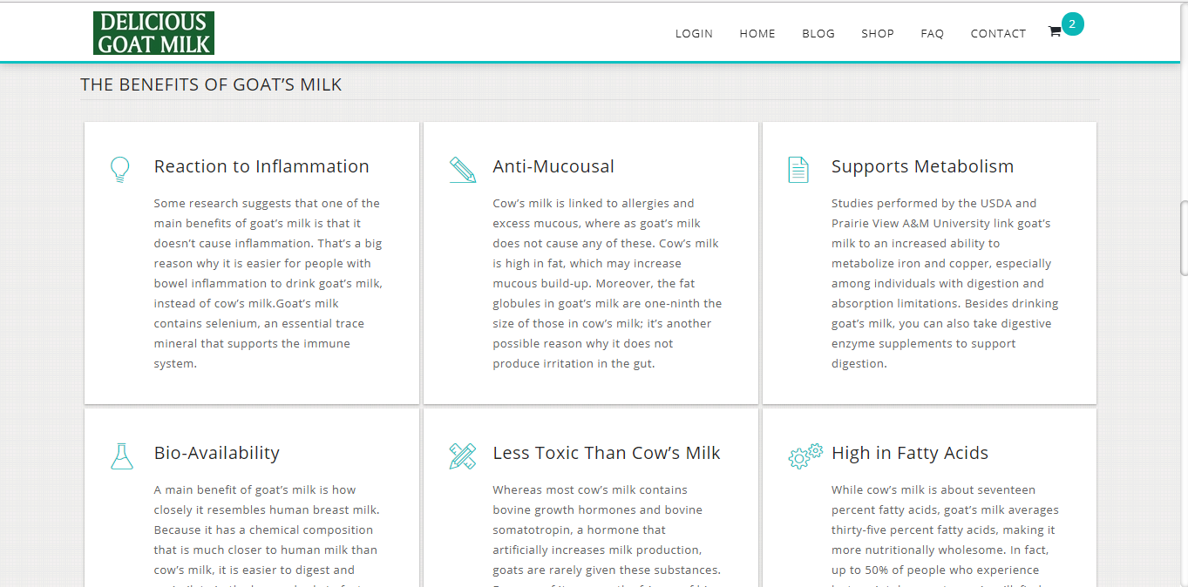
Home Page

Slide 6
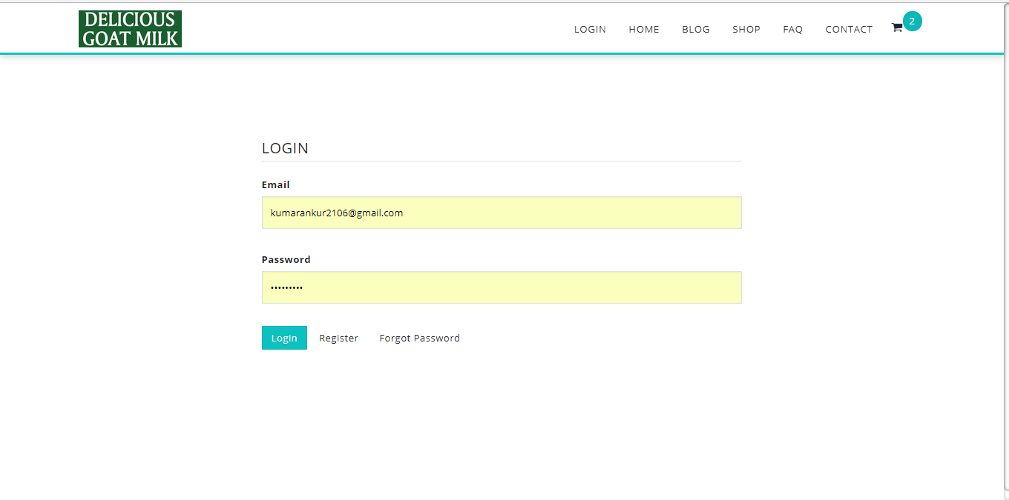
User Login Page

Slide 7
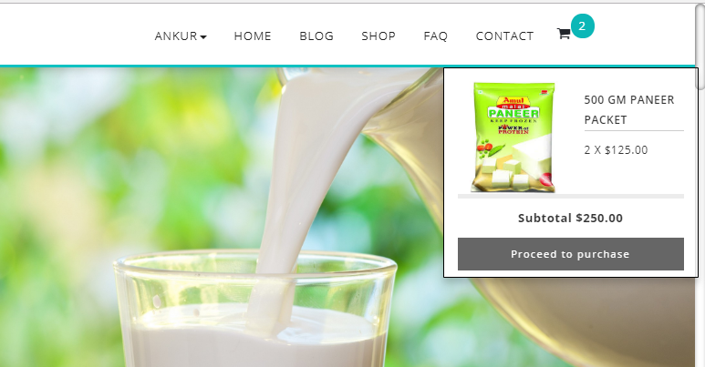
After Login Username Appers:

Slide 8
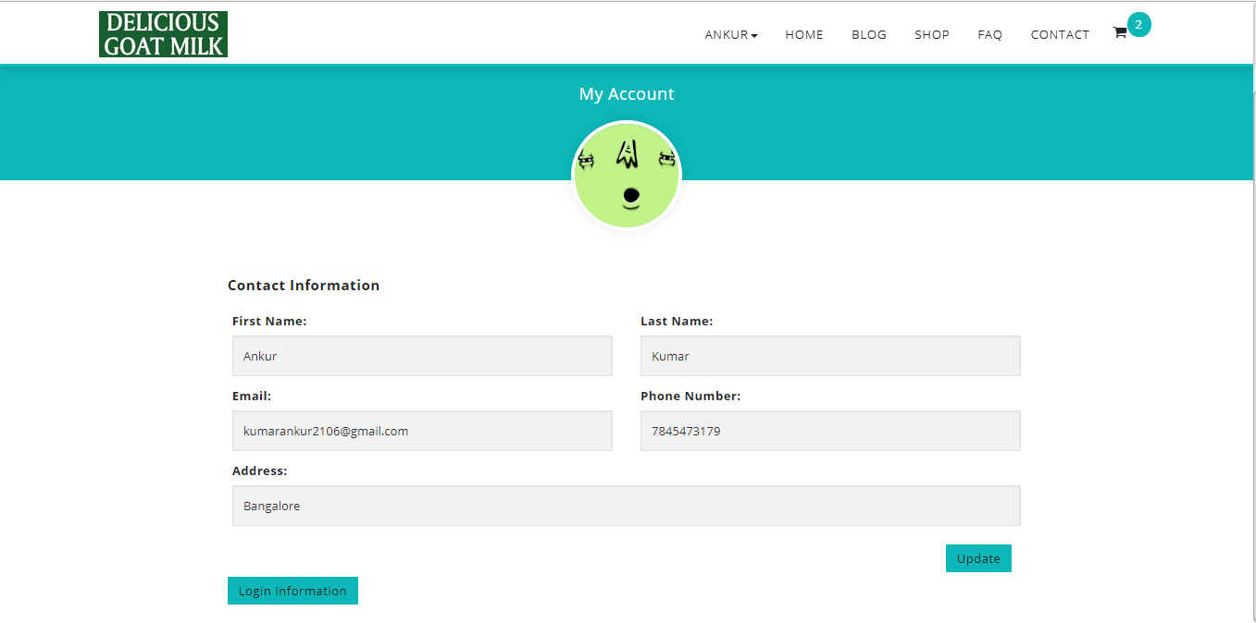
User Profile Page

Slide 9
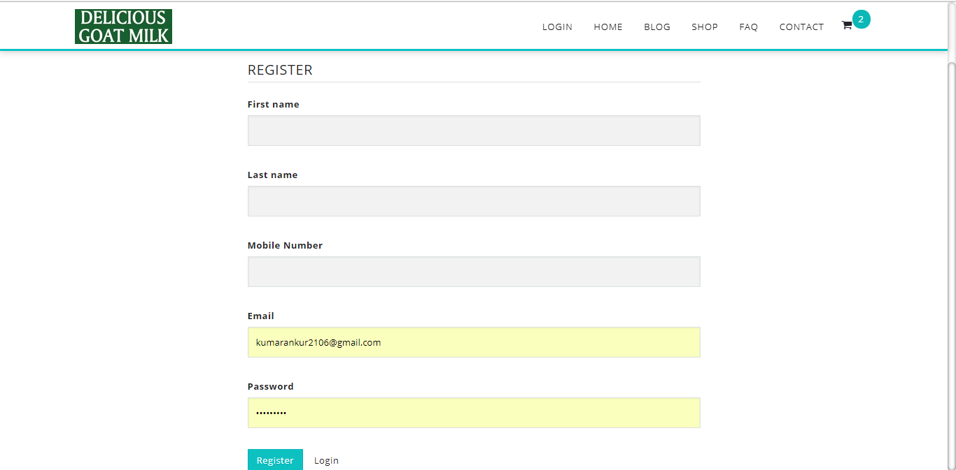
Register User Page:

Slide 10
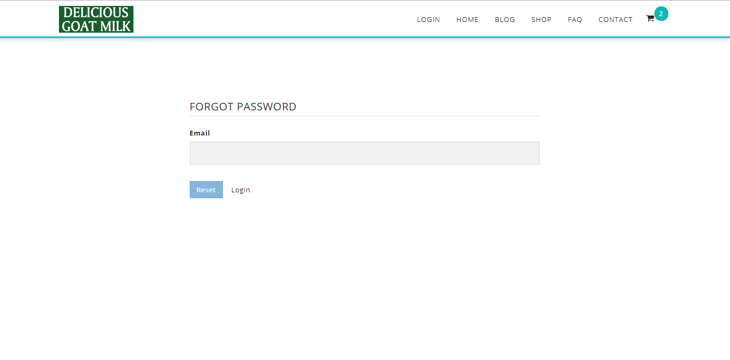
Forgot Password Page

Slide 11
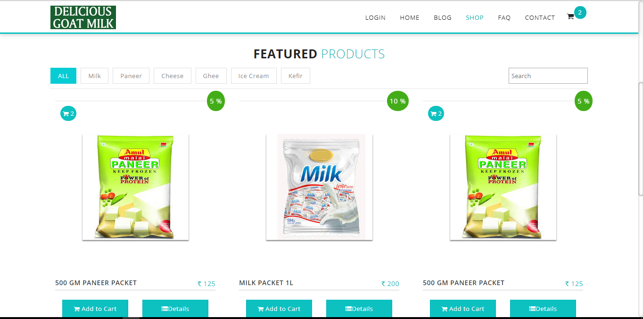
Products Page

Slide 12
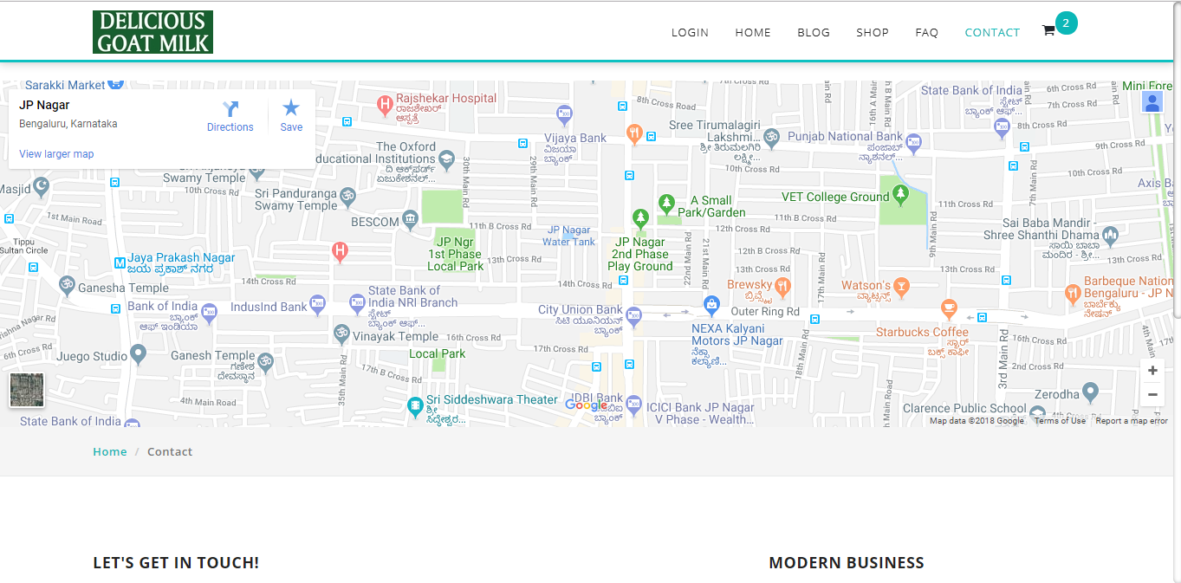
Contact Page

Slide 13
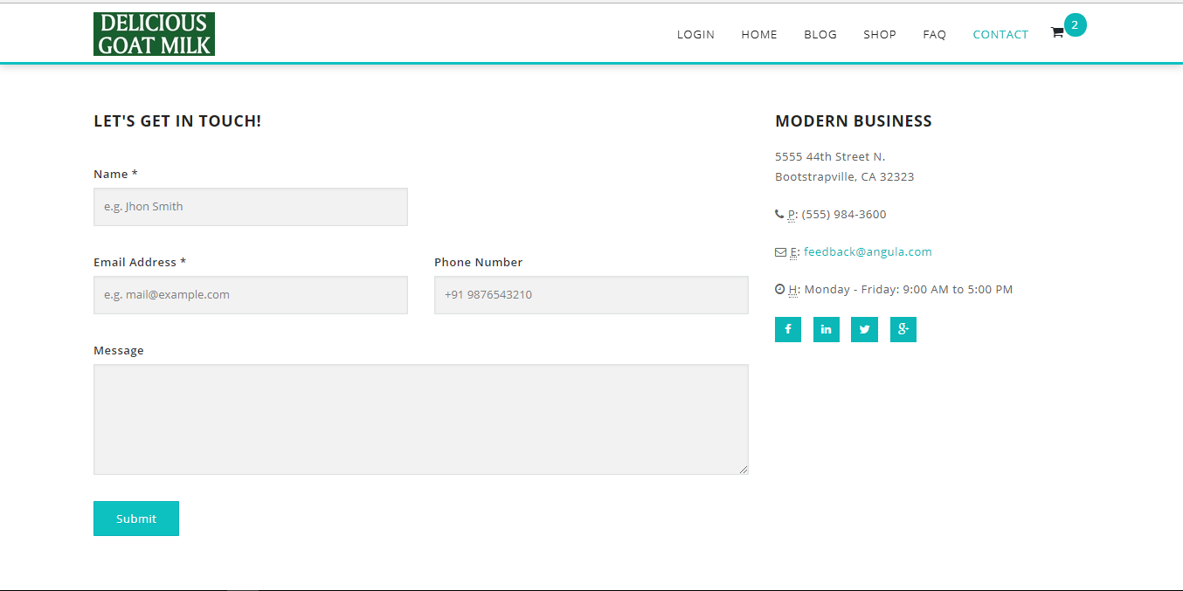
Contact Page

Slide 14
Contact Page

Slide 15
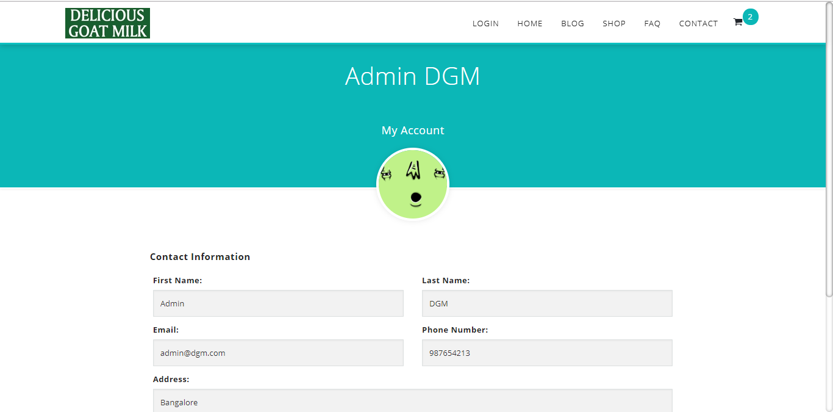
Admin Profile

Slide 16
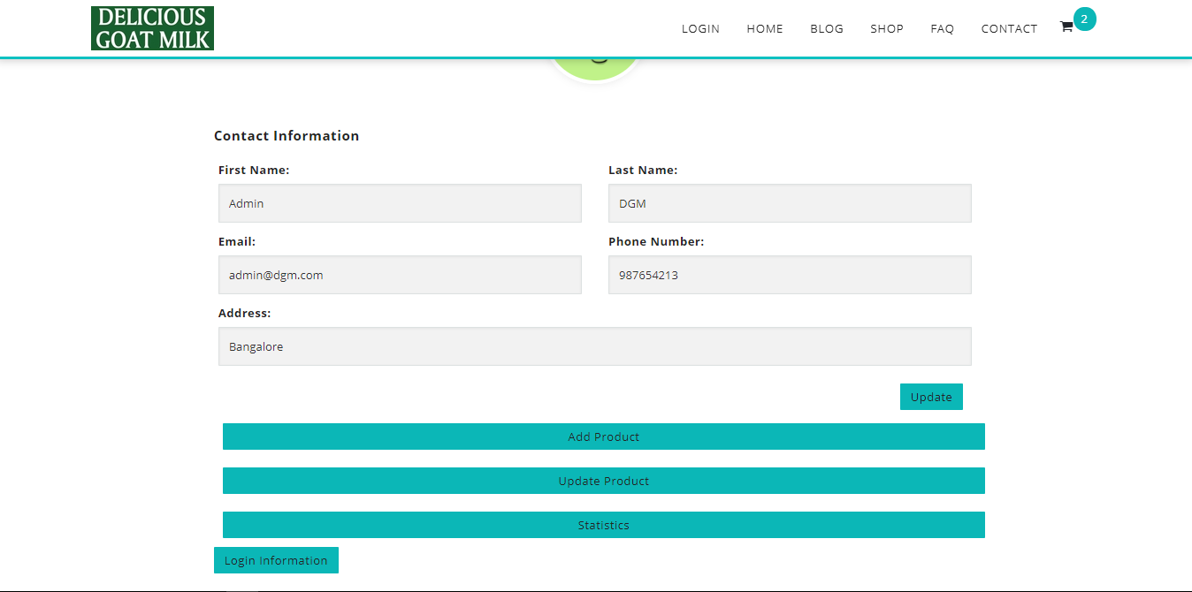
Admin Profile

Slide 17
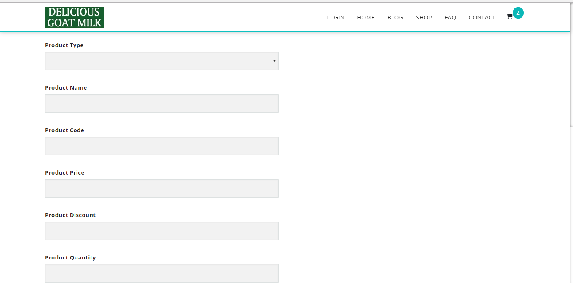
Add Product Page

Slide 18
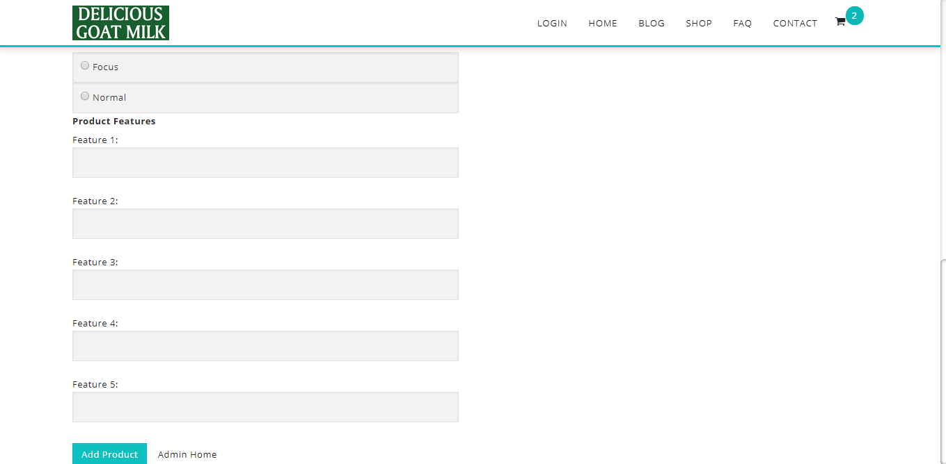
Add Product Page

Slide 19
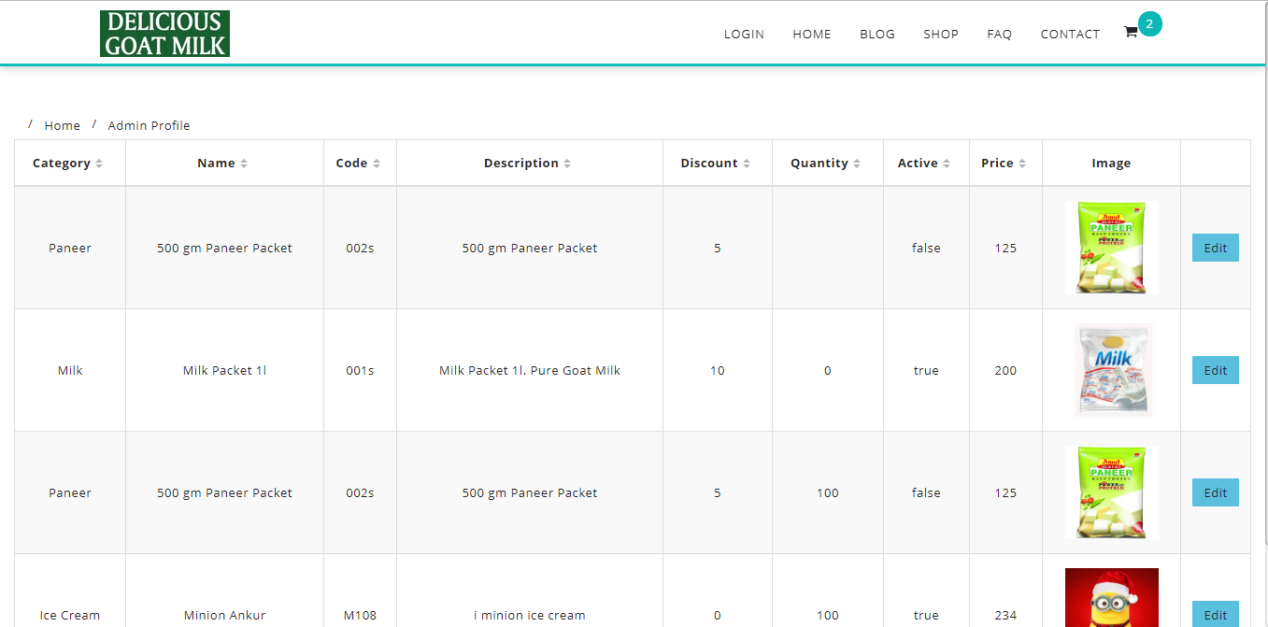
Update Product Page

Slide 20
Update Product Page

